Slide 1

Managing and Growing New Venture
MODULE 3

Slide 2
Roadmap
Preparing for the new venture launch: Early management decisions, Managing early growth of the new venture- new venture expansion strategies and issues.
Getting Financing or Funding for the New Venture: Estimating the financial needs of a new venture and preparation of a financial plan, Sources of Personal Financing, Preparing to Raise Debt or Equity Financing, Business Angels, Venture Capital, Initial Public Offering, Commercial Banks, Other Sources of Debt Financing, Leasing.
Forms of business organization: Sole Proprietorship , Partnership , Limited liability partnership - Joint Stock Companies and Cooperatives.

Slide 3
Launching An Entrepreneurial Venture
New ventures, or entrepreneurial ventures, are broadly defined as:
  those firms that are in their early stages of development and growth.
  Often they are in the process of bringing their initial products or services to the market and of developing their customer base.

Slide 4
Early management Decisions
The key to the success of an entrepreneurial team is to ensure that the right decisions are made initially on the composition of the team, and then on the composition of management, and later on monitoring of the team’s performance and contribution to the specific new venture goals and objectives..

Slide 5
Early management decisions
The composition of the team involves decisions on:
How many people are needed for the team
Where to source potential team members
What factors should be considered both on a professional and personal manner when finally choosing team members
The roles and duties of each team member
Their level of participation in the operational activities of the business
Exit mechanisms and procedures for team members

Slide 6
Sources of Funding for the New Venture
Own Finance
Debt or Equity Financing
Business Angels
Venture Capital
Initial Public Offering
Commercial Banks
Other Sources of Debt Financing
Leasing

Slide 7
Own Finance
Own Finance refers to capital invested in a business by its owners/investors. Being permanent, it creates no obligation by entrepreneurs to repay investors, but raising equity dilutes ownership.
Entrepreneurs must first look for individual resources for start up capital.
These include cash and any personal assets convertible into cash or simply converted to business use, for example, personal vehicles. This also includes cash from family/friends – love money

Slide 8
FINANCING THE BUSINESS
Early stage financing : refers to financial assistance required by the business during beginning of business operations. Two types of financing are available during this stage they are seed capital and start up capital.
Development financing : refers to an established business which is used for the purpose of expansion of business. Finance required at this stage is know as development or expansion financing.

Slide 9
Acquisition financing : it refers to finance required by the company for the purpose of acquiring other organizations.
Risk capital market: refers to market providing debt and equity to non secure financing institution.
Informal risk capital: markets consist of virtually invisible group of wealthy investors called as business angels.
Public equity market : risk capital market consisting of publically owned stock of companies.

Slide 10
ANGEL INVESTORS
Angles are early stage investors to business. Angle investors provide capital and valuable guidance to entrepreneurs. These investors along with financial capitals also provide intellectual capital to entrepreneurs.

Slide 11
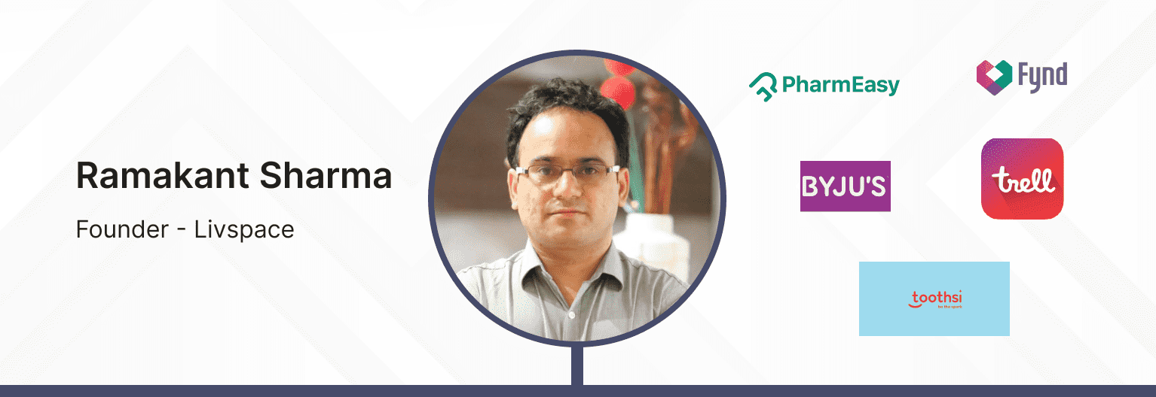
Angel Investors in India Example
Ramakant Sharma is an Active Angel Investor and Co-Founder of Livspace; he graduated from IIT Kanpur and held an MBA from the Indian School of Business, Hyderabad. Before starting Livspace, Ramakant was a core team member and Vice President of Engineering at Myntra, a leading fashion eCommerce startup in India.‍
Total Number of Investments: 76
‍Notable investments: PharmEasy, BYJU'S, Trell, Fynd, Toothsi.

Slide 12
FEATURES OF ANGEL INVESTOR
Understand the needs of business and are they able to provide useful expertise and assistance.
An angel investor is generally an independent wealthy person who takes risk on investment.
Angels take vested interest in the business start up in which they invest and become actively involved in the company to assist in other than financial aspects of business.

Slide 13
Angel investors help entrepreneurs create their business by assisting in funding, office infrastructure, sufficing management with required expertise to assist entrepreneurs in running the business.

Slide 14
Venture capital
Funds invested in companies in exchange for equity, which usually have a novel technology or business model in high technology industries, such as biotechnology and IT.
Or
Venture capital is money provided by investors to startup firms and small businesses with perceived long-term growth potential.

Slide 15
Intel capital
The firm focuses on mergers, acquisitions, and equity investments related to tech startups. Till date, it has invested $10.7bn in over 1,250 companies in 52 countries.
People You Should Know: Pradeep Tagare, Bhavanipratap Rana, Amit Behl, Sudheer K Kuppam.
Investment Structure: Invest between $300mn and $500mn per year.
Industries: Internet-Digital Media, Manufacturing-Labs, Security, Smart Phones-Tablets, software and Services, Ultrabook-Perceptual Computing, Wearables
Startups Funded: Gigya, Hungama, Snapdeal

Slide 16
Venture capital
Venture capital is early stage financing of new and young enterprises seeking to grow rapidly. Venture capitalist finances high and new technology based enterprises where the banks or financial institution generally support proven technology with established markets.
Venture capital is also described as unsecured risk financing. Venture capitalist directly purchase equity shares of entrepreneur and participates in the management of entrepreneur business.

Slide 17
FEATURES OF VENTURE CAPITAL
Investment by venture capital firms are made in high tech areas using new technology or producing innovative goods by using new technology.
Venture capitalist invest in long term start up costs at high risk, high reward project.
Return period may vary from seven to ten years. Investment of venture capitalist is neither repayable, return is possible only when share of company is sold at market price.

Slide 18
Venture capitalist not only invest in equity shares of company but also participate in management affairs of business.
Venture capitalist use their wide contact with the experts in technology and management areas and provide strategic input to entrepreneurial team in order to reduce uncertainties.
Venture capitalist firm encourage, nurture and help the entrepreneur grow because they have limited resources, high level of risk.

Slide 19
Investment by VCF are predominantly made in equity as shares because the dividends can be delayed till the company starts making profit.
VCF act as co partner in in entrepreneur business, share success and failure proportionate to equity investment by venture capitalist.

Slide 20
VENTURE CAPITAL PROCESS
Deal origination
Evaluation
Exit
IPO
Promoters buyback
Deal structuring
Post investment activities
Screening
Trade sale
Buy back of equity by company

Slide 21
VENTURE CAPITAL PROCESS
Deal origination : there are various VCF which have originated from India as well as foreign countries. It is essential for venture capital firm to have continuous source of deals in order to survive and grow in market.
Screening : VC firm carry out initial screening of all the project on the basis of some broad criteria. VCF usually prefer investing in technology related industry which involves development at large scale. E.g. Software industry, information technology, pharmaceuticals, bio technology, agriculture and allied industries. They ensure success rate of project before investing on the same.

Slide 22
Evaluation : as VCF investment is of huge amount and bare high risk, venture capitalist go in for detailed evaluation of business.
Deal structuring : once the venture capitalist has evaluated the proposal and found it to be viable, then VC and entrepreneur enter into contract which is known as deal structuring. Which includes details relating to a) VC right to control business b) board members c) right to replace management in case of poor performance d) buyback agreement and acquisition etc.

Slide 23
Post investment activities : success of VC activity depends on envisaging efficient mechanism from investment and successful implementation of disinvestment.
Initial public offer : benefits of disinvestment through IPO results in improved marketability, improved liquidity, better prospectus for capital gains and widely known status of the VC as well as market control through public share participation.

Slide 24
Promoters buy back : the promoters buy back VC stake at predetermined price and keep the ownership control with him. VC consider it as an exit option only when promoters are in position to mobilise funds for buy back of equity held by the venture investors.
Trade sale : VC may also disinvest his holdings through offer for sale to public. In this trade sale VC sells his stake to the strategic buyer who already owns a business or has plans to enter target industry.

Slide 25
Buy back of equity by company : as per the companies amendment act companies have been allowed to buy back their own equity shares. Even though the VC may not intent to exit through this route, he may consider as the venture has been failed to achieve high growth , below average performance of company.

Slide 26
Venture Capital firms
The venture capital industry may consist of: Wealthy individuals.
Foreign investors.
Private investment funds
Pension funds
Major corporations, e.g. Xerox

Slide 27
Types of Venture Capital firms
I. Private Venture Capital firms- A type of venture-capital firm having general and limited partners.
II. SBIC Firms- Small companies with some government money that invest in other companies.
III. Industry Sponsored Venture Capital Divisions- The Venture Capital divisions of major corporations usually associated with banks and insurance companies.
IV. State sponsored venture capital fund- A fund containing state government money that invests primarily in companies in the state.
V. University sponsored venture-capital fund-There are now university sponsored venture capital funds. These funds are usually managed as separate entities, invest in the technology of the particular industry.

Slide 28
Sources of Funding for the New Venture
Own Finance
Debt or Equity Financing,
Business Angels,
Venture Capital,
Initial Public Offering,
Commercial Banks,
Other Sources of Debt Financing,
Leasing.

Slide 29
Initial Public Offering (IPO
An initial public offering (IPO) refers to the process of offering shares of a private corporation to the public in a new stock issuance for the first time.
An IPO allows a company to raise equity capital from public investors.

Slide 30
IPO Process
Essentially consists of two parts.
The first is the pre-marketing phase of the offering,
Second is the initial public offering itself.
When a company is interested in an IPO, it will advertise to underwriters by soliciting private bids or it can also make a public statement to generate interest.

Slide 31
IPO Process
Proposals. Underwriters present proposals and valuations discussing their services, the best type of security to issue, offering price, amount of shares, and estimated time frame for the market offering.
Underwriter. The company chooses its underwriters and formally agrees to underwrite terms through an underwriting agreement.
Team. IPO teams are formed comprising of underwriters, lawyers, certified public accountants (CPAs), and Securities and Exchange Commission (SEC) experts.

Slide 32
IPO Process
Documentation. Information regarding the company is compiled for required IPO documentation. The S-1 Registration Statement is the primary IPO filing document.
It has two parts—the prospectus and the privately held filing information.1 The S-1 includes preliminary information about the expected date of the filing.2 It will be revised often throughout the pre-IPO process. The included prospectus is also revised continuously.

Slide 33
IPO Process
Marketing & Updates. Marketing materials are created for pre-marketing of the new stock issuance.
Underwriters and executives market the share issuance to estimate demand and establish a final offering price.
Underwriters can make revisions to their financial analysis throughout the marketing process.
This can include changing the IPO price or issuance date as they see fit. Companies take the necessary steps to meet specific public share offering requirements. Companies must adhere to both exchange listing requirements and SEC requirements for public companies.

Slide 34
IPO Process
Board & Processes. Form a board of directors and ensure processes for reporting auditable financial and accounting information every quarter.
Shares Issued. The company issues its shares on an IPO date. Capital from the primary issuance to shareholders is received as cash and recorded as stockholders' equity on the balance sheet. Subsequently, the balance sheet share value becomes dependent on the company’s stockholders' equity per share valuation comprehensively.
Post IPO. Some post-IPO provisions may be instituted. Underwriters may have a specified time frame to buy an additional amount of shares after the initial public offering (IPO) date. Meanwhile, certain investors may be subject to quiet periods.

Slide 35
Leasing
A lease is a contract outlining the terms under which one party agrees to rent an asset—in this case, property—owned by another party.
It guarantees the lessee, also known as the tenant, use of the property and guarantees the lessor (the property owner or landlord) regular payments for a specified period in exchange.

Slide 36
Leasing
A lease is a legal, binding contract outlining the terms under which one party agrees to rent property owned by another party.
It guarantees the tenant or lessee use of the property and guarantees the property owner or landlord regular payments for a specified period in exchange.
Residential leases tend to be the same for all tenants, but there are several different types of commercial leases.

Slide 37
Both the lessee and the lessor face consequences if they fail to uphold the terms of the contract. A lease is a form of incorporeal right.

Slide 38
Leasing
Consequences for breaking leases range from mild to damaging, depending on the circumstances under which they are broken.
Certain protected groups are able to vacate their leases without any consequences, for which some form of proof is usually required.

Slide 39

WHAT IS A BUSINESS ORGANISATION?
The term "business organization" refers to how a business is structured.
It refers to a commercial or industrial enterprise and the people who constitute it.

Slide 40

Types Of Business Organisations
Sole Proprietorship
Joint Hindu Family Business
Partnership Firm
Joint Stock Company 1.) Private Limited 2.) Public Limited
Co-operative Society

Slide 41

Choosing a Form of Business Organisation
The choice of the form of business is governed by several interrelated and interdependent factors :-
The nature of business is the most important factor
Scale of operations i.e. volume of business ( large, medium, small) and size of the market area (local, national, international)

Slide 42
The degree of control desired by the owner(s)
Amount of capital required for the establishment and operation of a business
The volume of risks and liabilities as well as the willingness of the owners to bear it
Comparative tax liability

Slide 43


Sole Proprietorship
When the ownership and management of a business are in control of one individual the form of business is called sole proprietorship.

Slide 44
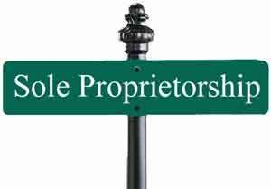
Characteristics
The business enterprise is owned by one single individual (i.e. both profit and risk belong to him)
Owner is the Manager
Owner is the only source of Capital
The proprietor and business enterprise are same in the eyes of the law.

Slide 45
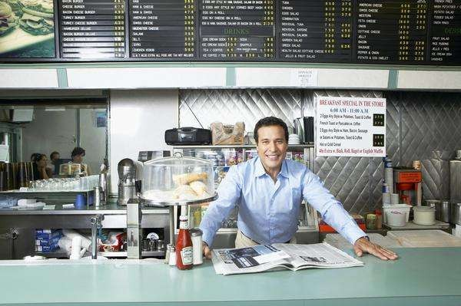
Advantages Of
Sole Proprietorship
Easy formation
Better Control (Prompt decision making and Flexibility in Operations)
Subject to fewer regulations
Not subject to corporate income tax
Ownership of all profits

Slide 46

Disadvantages Of Sole Proprietorship
Owner has unlimited liability
Difficult to raise capital
Business has a limited life
Difficult to do business beyond a certain size

Slide 47
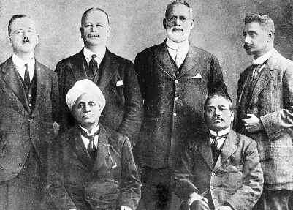
JOINT HINDU FAMILY BUSINESS
Comes into existence as per the Hindu Inheritance Act of India
This form of business found only in India
All members of the Hindu Undivided Family(HUF) own the business jointly
The affairs of the business are managed by head of the family called “Karta”. All other members are called “Co-parceners”

Slide 48

Membership is restricted only to members of the Joint family. No outsider can become the member
Karta has unlimited liability while all other members have limited liability
The share of each member keeps on fluctuating
Business continues to exist upon the death of any member or Karta.

Slide 49

ADVANTAGES OF HUFs
Every person has an assured share in profits
The business has continued existence
Decision making is quick as the powers are with the Karta
No corporate tax
People use it mostly for tax benefits these days

Slide 50

DISADVANTAGES OF HUFs
Absolute power in the hands of Karta.
Instability
Limited Resources can be raised.
Scope for conflict

Slide 51

PARTNERSHIP FIRM
A Partnership consists of two or more individuals in business together

Slide 52
CHARACTERISITCS OF PARTNERSHIP
Minimum 2 number of partners and maximum 20 partners
The relation between the partners is created in the form of a contract. Written contract is called
“Partnership Deed”
The firm means partners, the partners mean the firm
The profit is divided in any as ratio as agreed
No partner can sell/transfer his interest in the firm to anyone without the consent of other partners

Slide 53

ADVANTAGES OF PARTNERSHIP
Easy Formation
Larger Resources
Sharing Of Risk
Better Management and Flexibility of Operation
No corporate income tax
Subject to fewer regulations as compared to companies

Slide 54

DISADVANTAGES OF PARTNERSHIPS
Unlimited Liability
Limited Life
Difficult to raise capital
Chances of Dispute

Slide 55
JOINT STOCK COMPANY
A joint stock company is a voluntary association of people who contribute money to carry on business

Slide 56

CHARACTERISTICS OF A CORPORATION
It is considered as a separate legal entity.
It comes into formation after all formalities under the Indian Companies Act 1956 are completed.
Management and ownership is completely separate.
Capital is raised through shares which are transferable.

Slide 57

ADVANTAGES OF A CORPORATION
Limited liability of the shareholders/promoter
Can easily raise capital
Have unlimited life
Ease of transfer of ownership

Slide 58
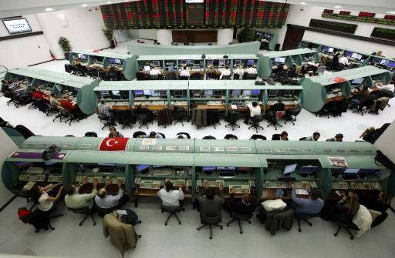
DISADVANTAGES OF A CORPORATION
Formation is not easy
Excessive Government Regulation
Subject to Corporate Tax and Dividend Tax (Double Taxation)
Delay in Policy Decisions
Control by a Group

Slide 59
TWO TYPES OF CORPORATIONS
1. PRIVATE COMPANY
Closely held by a few people
Minimum 2 and maximum 50 shareholders
Stocks cannot be traded on exchanges and private equity cannot be raised
Less regulations as compared to Public Companies

Slide 60
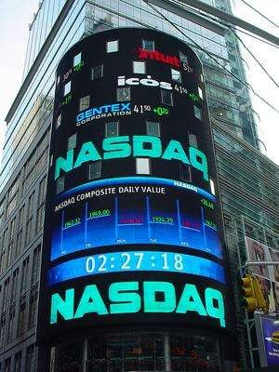
2. PUBLIC COMPANY
Stocks are held by a large number of people
Minimum 7 shareholders and no limit for maximum
Can be listed on stock exchange and can go public
Have to follow many laws with regards to the board composition.

Slide 61

CO-OPERATIVE SOCIETY
It is a voluntary association of people or business to achieve an economic goal with a social perspective

Slide 62
CHARECTERISTICS OF CO-OPERATIVE
Voluntary association
Minimum membership requirement is 10 and there is no maximum limit
Registration of Co-operative is must
under the “Co-operative Societies Act” is a must. After the registration it enjoys certain privileges of a Joint Stock Company

Slide 63

ADVANTAGES OF CO-OPERATIVE
Easy Formation
Limited Liability
Stability
Democratic Management
State Assistance

Slide 64

DISADVANTAGES OF A CO-OPERATIVE
Possibility of conflict
Long decision making process
Not enough capital

